Slide 1
An Exclusive Logistics Solution

Slide 2

Philosophy
To be recognised by every team member, customer and business partner as a company that creates innovative, practical and measurable solutions that produce exceptional and sustainable results.

Slide 3
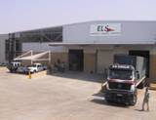
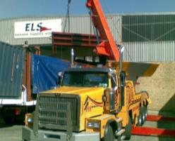
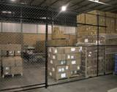
Position
In an industry undergoing global consolidation and increased commoditisation, the opportunity presents itself for the formation of a boutique business model focusing on highly personalized business relationships built from a foundation of customized process management, measurement and meaningful communication.

Slide 4
Ethos
We thrive on the individuality of our customers and the dynamic nature of their industries. It is from this background that we seek to understand their strategic direction and challenge the status quo for sustainable solutions. There is no greater reward than delivering a result intact, in place, on budget and on time.
There is no substitute for quality and confidentiality
Service and integrity above financial returns
Team members take first priority in every aspect
Customers, suppliers and international agents are treated with mutual respect
Challenge the status quo for continuous improvement
Creativity and individuality are pre requisites
We don't close deals, we open relationships
Driven by passion and take pride in exceeding both our own and our customer's expectations
We will not sacrifice our values for anything!

Slide 5
Background
Established in South Africa in 2005
Opportunity for boutique business model
Increased demands from customers
Focus on personalised business relationships
Service delivery culture
Create innovative, creative, measurable solutions for exceptional and sustainable results

Slide 6
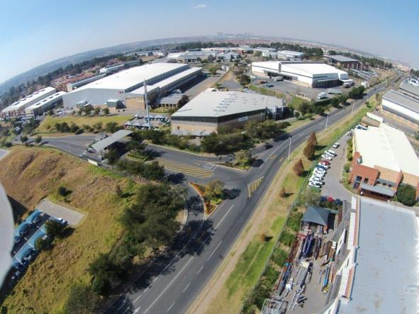
Achievements
World Cargo Alliance Award Winner for Africa
Level 2 BEE Business Certification
Representatives in 196 countries
5000m² owned warehouse
Nationwide representation
Celebrating 10 years of personalised solutions and service excellence in 2015

Slide 7
Imagine If..
You dealt with a company you trusted
You were treated as a business partner
You had one point of contact for all your business needs
You could enter and exit markets without any process changes
Your supplier enhanced your profitability
You had access to all levels in the company
You had total visibility into your supply chain
Your supplier adapted to your way of working
You experienced personalised service and felt part of a team
Your products were in place, on time and intact, every time
Your challenges were met with real solutions

Slide 8
Services
International Air Freight Forwarding
International Ocean Freight Forwarding
Logistics Services
In-house Customs Broking
Insurance
Project Cargo
Fairs and Exhibitions
Vertical Industry Focus
Trade Finance

Slide 9
Solutions
Our Business Management model sets us apart, and puts you in the driver seat 24 hours a day, 7 days a week
One Business Manager - One point of contact
Solution Based - Rapid decision making
24 hours a day, 7 days a week - Total availability
Customised Service Level Agreements - Flexibility
Standard Operating Procedures - Reliability
Continuous Process Improvement - Innovation
Performance Measurement - Accuracy
Status Reports – Real time information

Slide 10
Vertical Industry Specialisation
Pharmaceutical
Cold Chain and Clinical Trials
Aviation and Aerospace
Fairs and Exhibitions
E-waste recycling
High value, time definite industries

Slide 11

Network
Integral member of WCA
  Voted Best Agent in Africa
Through network, offices in 196 countries
Hand picked specialists in the major markets
Total continuity
Strong relationships in our network over 20 years
Competitiveness, consistency and speed of decision making

Slide 12
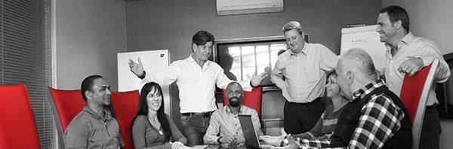
Leadership Team
Leading, Empowering and Protecting the business

Slide 13
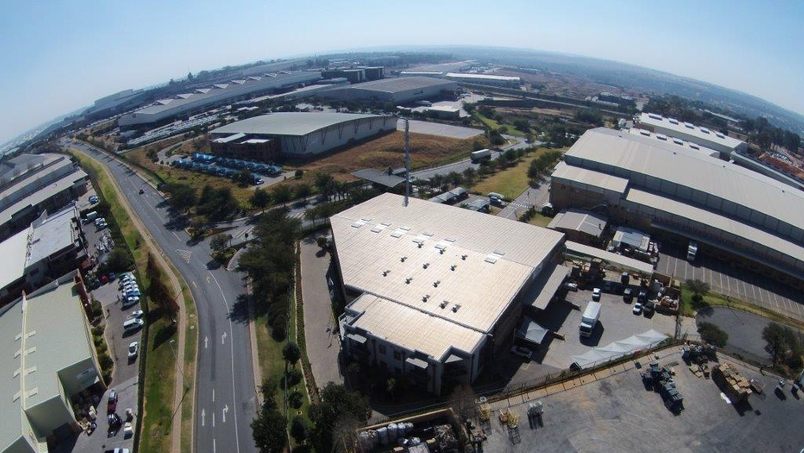
Location
Perfectly located in Longmeadow Business Estate

Slide 14
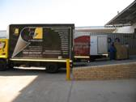
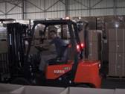
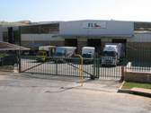
Warehouse & Distribution
5000m²
Bonded and caged areas
Racking and refrigeration
Cold chain management
State-of-the-art security
Configure to order
Vendor Managed Inventory
Pick and pack operations
Local and regional distribution

Slide 15
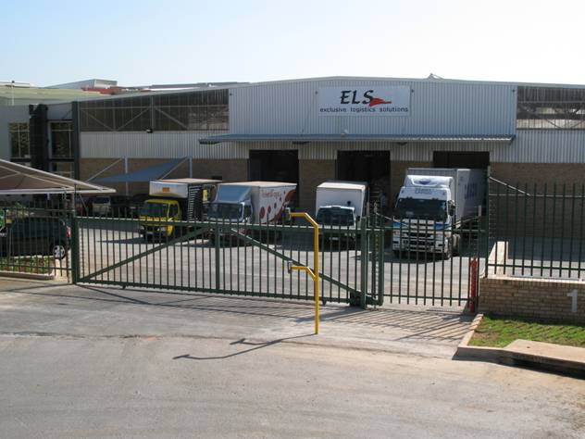
5000m²Facility

Slide 16
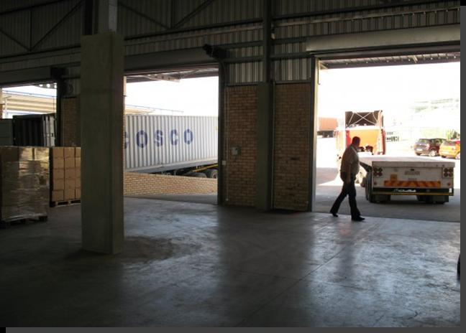
Loading Bays & Dock Levellers

Slide 17
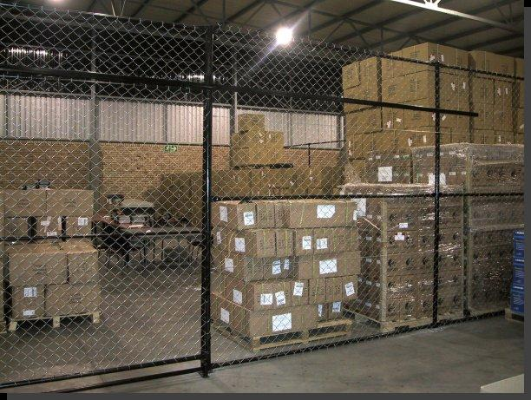
Bonded & Caged Areas

Slide 18
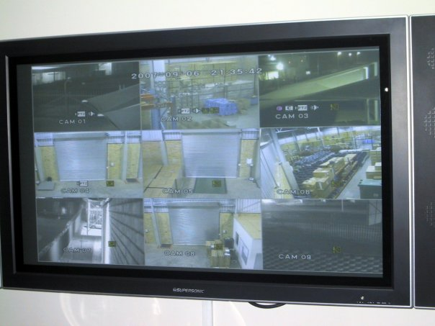
Internet Based Security Systems

Slide 19

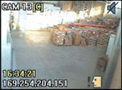
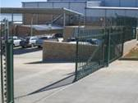
Security
Electric perimeter fence linked to intrusion system
Facility wide CCTV coverage - 16 cameras with motion detection & recording to embedded DVR
Total access control
40 Zone intrusion detection
24/7 Storage fridge temperature monitoring
24/7 armed reaction

Slide 20
Quality
We are obsessive about providing you with your possessions in tact, in place and on time. Performance is measured against your requirements in the form of an on-time delivery (OTD) summary. This encompasses 5 major steps:
  Available
  Pick-up
  On carrier
  Arrival
  POD
You are immediately informed of any potential delay that may occur at any stage in the above steps
Invoicing accuracy in line with your agreed pricing is reinforced and any form of demurrage is qualified

Slide 21




Proudly Supporting

Slide 22
Thank You
exclusive logistics solutions
Johannesburg • Durban • Cape Town

